Slide 1

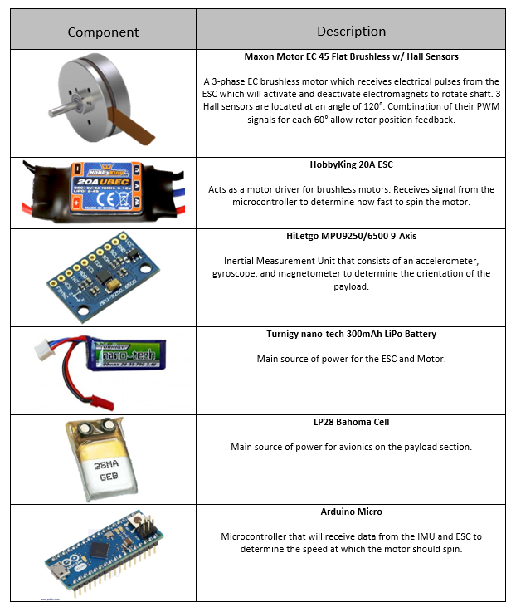
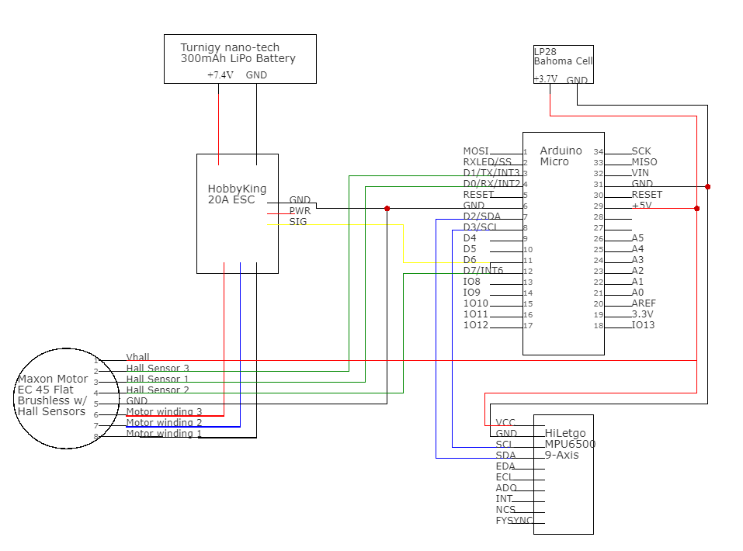
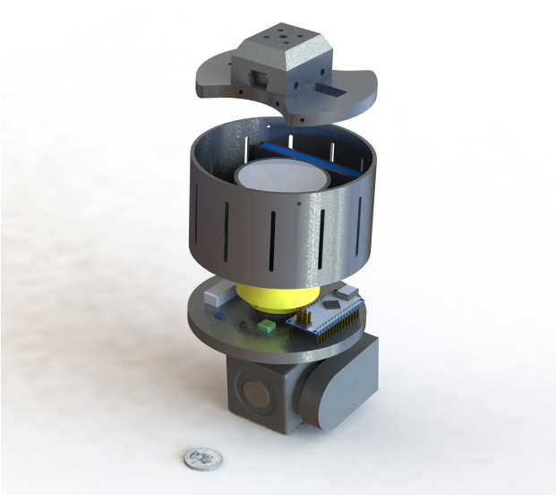
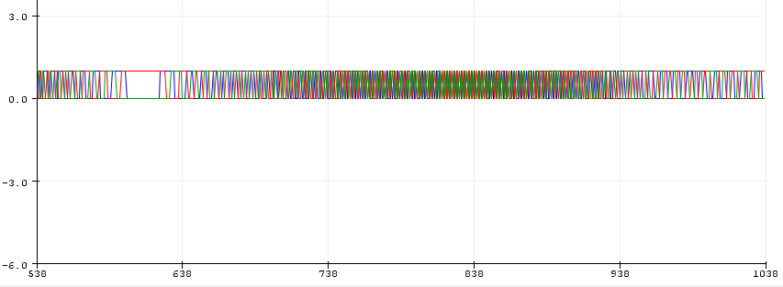
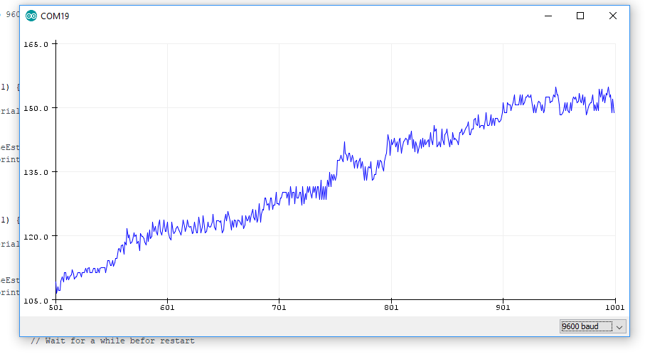
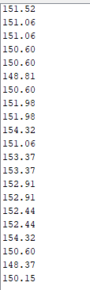
Payload Stabilization and Pointing for an All-Rotating Aerial Vehicle
Jessica Crisantes, Dr. Praveen Shankar
Mechanical and Aerospace Department, College of Engineering
INTRODUCTION:
A design has been developed consisting of an all-rotating aircraft bio-inspired by samaras that promises advantages in simplicity, efficiency, and stealth. However, this design poses the challenge of tracking an object in an all-rotating reference frame. My team was assigned to design, fabricate, and integrate a pointing de-spun payload for use on the all-rotating aircraft. As the lead of electronics, I chose the electrical components that best met our mission requirements. I chose electronics based on the need for rotation sensing, position sensing, power consumption, response time, and simplicity. I decided to place my electronics on our stabilized payload section, therefore the electronics do not have to withstand a high RPM. Using an IMU, HiLetgo MPU9250/6500, consisting of a gyroscope, accelerometer, and magnetometer to obtain the position of the payload to interface with a microcontroller, Arduino Micro, and an embedded EC motor, Maxon Motor EC 45 Flat Brushless with Hall Sensors, to stabilize the payload. In addition, data will be collected from the MEMS Sensors on the IMU and used for control law derivation as well as record commands and inputs needed to generate commands in telemetry file output.
ELECTRICAL
The team was tasked to design an iteration of the previous prototype. We mainly focused on designing a more lightweight and small-scale system. A major factor in designing a smaller system, was my decision to move the electronics to the payload section. By doing so, the team cut over half the original length of the electronics bay. Additionally, I chose the Maxon Motor EC 45 Flat Brushless with Hall Sensors which is half the length of the previous prototype’s motor, 2,737 RPM Premium Planetary Gear Brush Motor. Furthermore, I chose a smaller and lighter battery, Turnigy nano-tech 300mAh LiPo Battery, which additionally shortens the electronics bay. The payload bay will consist of an IMU, HiLetgo MPU9250/6500, a microcontroller, Arduino Micro, and an avionics battery, LP28 Bahoma Cell. The team also designed a more aerodynamic and versatile mechanical system.
METHODS:
The team and I utilized the engineering design process which includes a methodical series of steps: research, design, build, test. First, we analyzed the mission requirements. Additionally, we researched which electrical and mechanical components would perform the best for our mission and could fit within our size constraints. Once the design process is complete, the team will build protypes of the design options and test them using a variety of tests.
Fig. 2. Electrical Wiring Diagram
DESIGN:
MECHANICAL
RESULTS:
I conducted two tests to receive various data to help improve selected electrical components. The first test consisted of connecting a power supply to my system and reading what current the motor drew when given 7V and reached its max RPM. Utilizing the 3 hall sensors to read the change in the electromagnetic field, which is unique at every 60° and will give a state of 0 or 1 (Fig. 3.), on the Maxon Motor 45 EC brushless, I found that the motor drew 0.22A at a max RPM of about 1550 (no load) (Fig. 4). The second test was testing the runtime for the system. Since the motor draws 0.22A at the max RPM, I chose a battery based off the required capacity and runtime, 300mAH and 0.5 hrs. To meet these requirements, I found the best fit choice to be the Turnigy nano-tech 300mah LiPo battery. I then supplied my system with this battery and ran an Arduino code that would allow the RPM to rise to max rpm (1550) and hold for 10s, then fall to min rpm (0) continuously. By executing this test, I found the runtime for the system to be about 27min.
Axis of rotation adjustment mechanism
RPM
RPM
Motor Housing
State
Hall Sensor 1
Hall Sensor 2
Hall Sensor 3
Stabilized payload section
Fig. 3. Hall Sensors state transitions
Microseconds
Fig. 4. Motor rising to max RPM
Microseconds
Payload
FUTURE WORK:
As the project is currently ongoing, there is more research, design, and testing to complete. I will be working on an Arduino code to interface the sensors, microcontroller, and the embedded EC motor. In addition to this, the team will collaborate on designing a pointing system.
ACKNOWLEDGMENTS:
I’d would like to thank my faculty adviser, Dr. Praveen Shankar, for giving me the opportunity to work on this project as well as supporting the team throughout this project. As well as my team members Oliver Chaing, Tanner Prince, Thomas Swaney, for the hard work they’ve done. Additional help was provided by Ryan Moffit Alexander Littleton, and Christopher Senner.
Fig. 1. Payload and Motor Housing CAD

